Slide 1
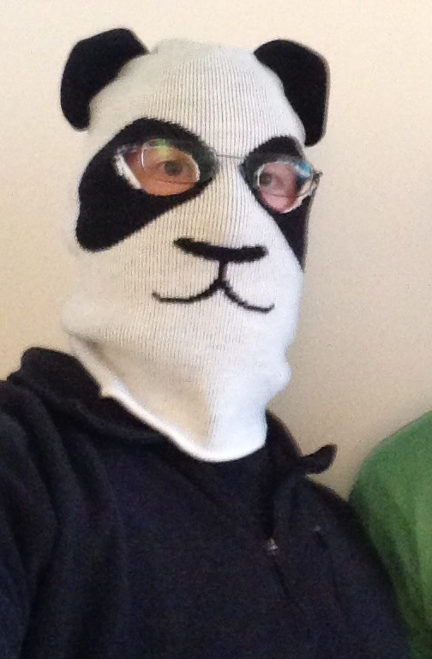
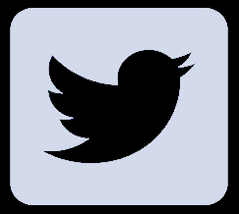


Advancing
FOCUS
FOCUS
Glen R. Goodwin
@areinet
arei.net
github.com/arei
Notes:
Greetings everyone.
My name is Glen
and I am here today
to talk to you about
THE MOST EXCITING PART

Slide 2

Notes:
of working with browsers
<quick pause>
A topic
mind you
that will LITERALLY

Slide 3
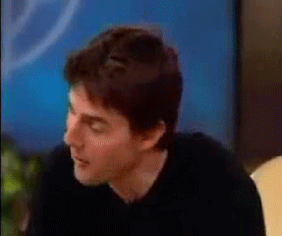
Notes:
make you shout with joy
<quick pause>
and I can tell you are
all SUPER EAGER

Slide 4

Notes:
to hear about
the stupendous

Slide 5
STUPENDOUS
Notes:
amazing

Slide 6
AMAZING
Notes:
and totally riveting...

Slide 7
TOTALLY RIVETING
Notes:
and totally riveting...

Slide 8
Focus Subsystem
Notes:
Focus Subsystem!
<ADVANCE FAST>

Slide 9
WTF?!
<NEEDLE-SCRATCH/>
Notes:
Focus Subsystem!
[Slide: WTF?!?]
[Sound: Needle Scratch]
<pause>

Slide 10
Focus Subsystem
Notes:
Alright,
I know this isn't
the most glamorous thing
we could be discussing

Slide 11
Focus Subsystem
Notes:
but sometimes
we have to get a little bit
down in the weeds
and take a long hard look
at the tools we are given
as web developers
and ask
could it be better.

Slide 12
Focus Subsystem
Notes:
And that's what I want to do today
with the Focus Subsystem...

Slide 13
Focus Subsystem
Notes:
I am going to dig
a little bit
into focus
what it is
and how it works
and ask is it doing
enough for us

Slide 14
Focus Subsystem
Notes:
Alright,
I know this isn't
the most glamorous thing
we could be discussing

Slide 15
Does it work well?
Notes:
Does it work well?

Slide 16
Does it work well?
Does it meet the needs of the developers?
Notes:
Does it meet
the needs of the developers?

Slide 17
Does it work well?
Does it meet the needs of the developers?
Could it do more to be better?
Notes:
Could it do more
to be better?
<pause>
<water>

Slide 18
Focus
Notes:
In order to answer
these questions
we need to know
what exactly we are talking about
and where it comes from,
So,
Very simply
and glossing over a lot of details...

Slide 19
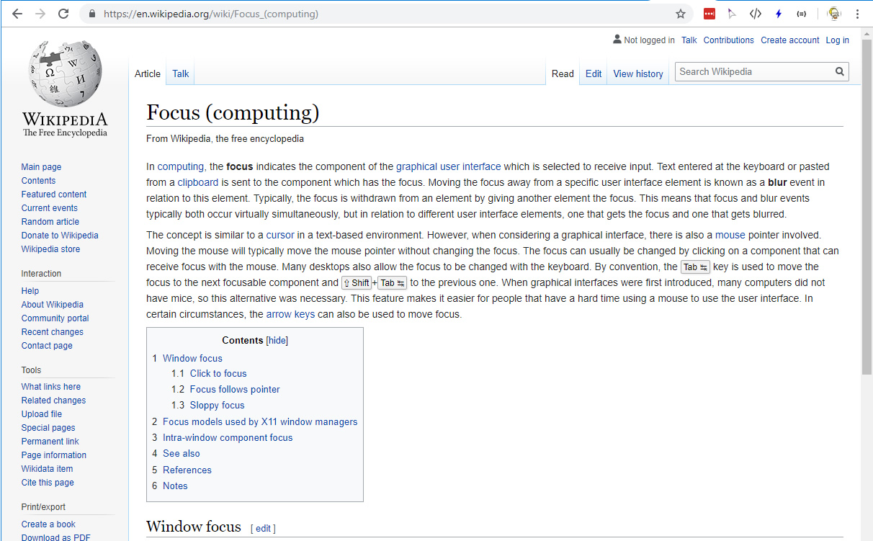
Notes:
Focus,
as it relates to user interfaces,
is the process
by which the computer
decides what part of the user interface
receives any human interaction.
A mouse click, a keystroke, etc.

Slide 20
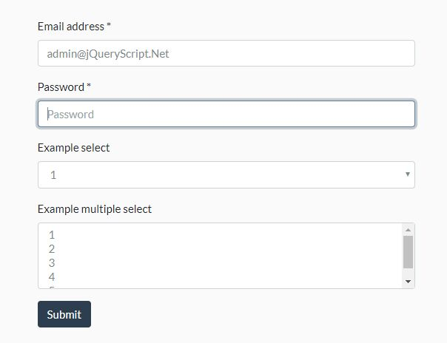
Notes:
And for any given
human interaction
only one piece,
only one field,
can be the focus
at any given time.

Slide 21
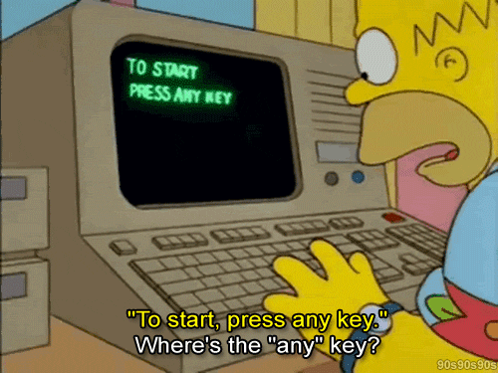
Notes:
when we press a key
The keyboard reports to
the operating system
which determines what key was pressed.

Slide 22
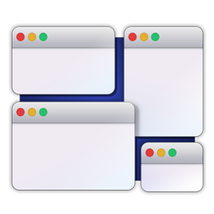
Notes:
The operating system
then determines where the user
is currently targeting
their input at...
more precisely,
which window,
is the focus.
If the browser
is the current window focused,
it tells the browser
about the keyboard press.

Slide 23
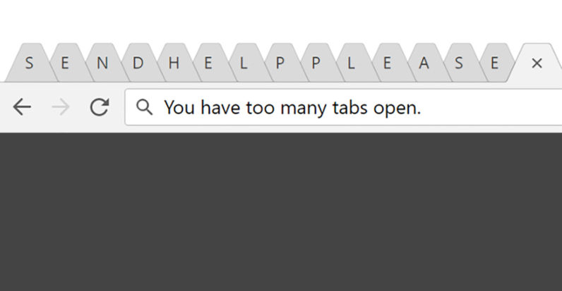
Notes:
The browser then does
exactly what the Operating system did
and it determines which window or tab,
within the browser,
is currently targeted
to receive input.

Slide 24
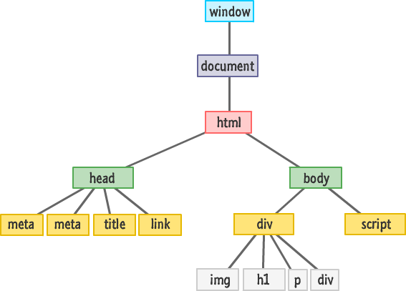
Notes:
Once the browser has determined
which window or tab
has the focus,
it gets the associated top-level DOM document
for that window or tab.
The top-level DOM Document
tracks which specific element
in the DOM
that is currently targeted
to receive input.

Slide 25
document.activeElement
Notes:
This is called the "activeElement".
The key press is then
translated into an event
and the event is then fired
with the activeElement
as its target.

Slide 26
Keyboard
Operating System
Application (Browser)
Tab/Window
Document
Element
Notes:
So we can see
that focus
is a series of decisions
at every level.
From the operating system level
to the application level
to the DOM level.
<pause>

Slide 27
Properties
document.activeElement
Methods
element.focus()
element.blur()
Events
focus
blur
focusin
focusout
Notes:
The activeElement,
together with the focus related events
(focus, blur, focusin, focusout)
and the element.focus() and the element.blur() functions
make up the focus subsystem.

Slide 28
Properties
document.activeElement
Methods
element.focus()
element.blur()
Events
focus
blur
focusin
focusout
Notes:
ActiveElement tells us
what is currently focused

Slide 29
Properties
document.activeElement
Methods
element.focus()
element.blur()
Events
focus
blur
focusin
focusout
Notes:
The focus() method
is used to set
the active focus

Slide 30
Properties
document.activeElement
Methods
element.focus()
element.blur()
Events
focus
blur
focusin
focusout
Notes:
The blur() method
is used to clear
the active focus.
Interesting note,
what happens to the focus
when you call blur()
is entirely up to
the browser
and just about anything
could happen.

Slide 31
Properties
document.activeElement
Methods
element.focus()
element.blur()
Events
focus
blur
focusin
focusout
Notes:
The focus event
occurs whenever an element
becomes the active focus

Slide 32
Properties
document.activeElement
Methods
element.focus()
element.blur()
Events
focus
blur
focusin
focusout
Notes:
The blur event
occurs whenever an element
loses the active focus

Slide 33
Properties
document.activeElement
Methods
element.focus()
element.blur()
Events
focus
blur
focusin
focusout
Notes:
The focusin event
occurs whenever an element
is about to
become the active focus

Slide 34
Properties
document.activeElement
Methods
element.focus()
element.blur()
Events
focus
blur
focusin
focusout
Notes:
The focusout event
occurs whenever an element
is about to
lose the active focus

Slide 35
Properties
document.activeElement
Methods
element.focus()
element.blur()
Events
focus
blur
focusin
focusout
Notes:
This is everything the browser
programmatically gives us
to understand focus
and manipulate it.
That's it.
In its entirety.
And That's what we are talking about today.
The focus subsystem.
These 7 pieces.
<short pause>
<water>

Slide 36
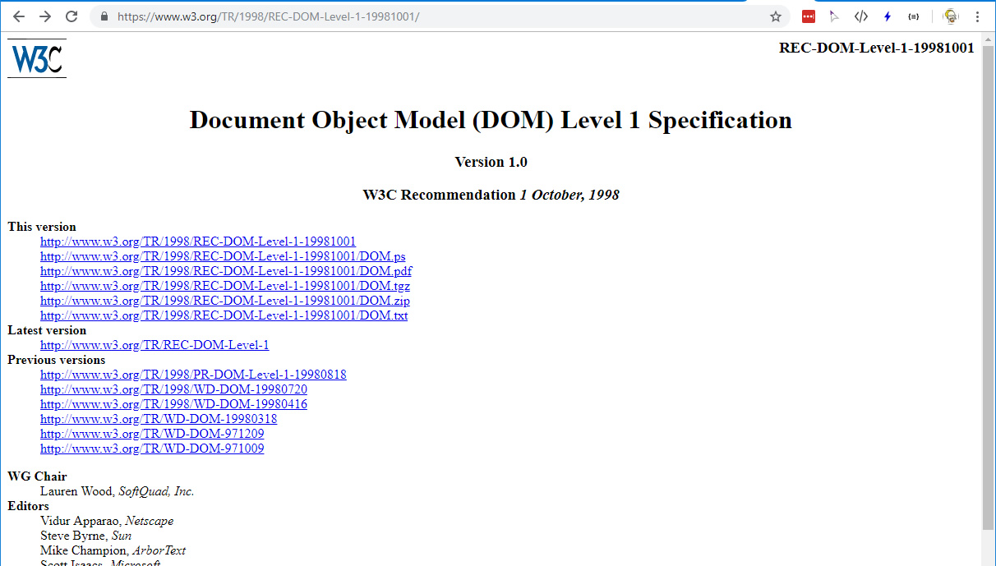
Notes:
The focus subsystem
was first formally added
to the Document Object Model Specification Level 1
in January of 1998,
with a few minor tweaks
a few years later.

Slide 37
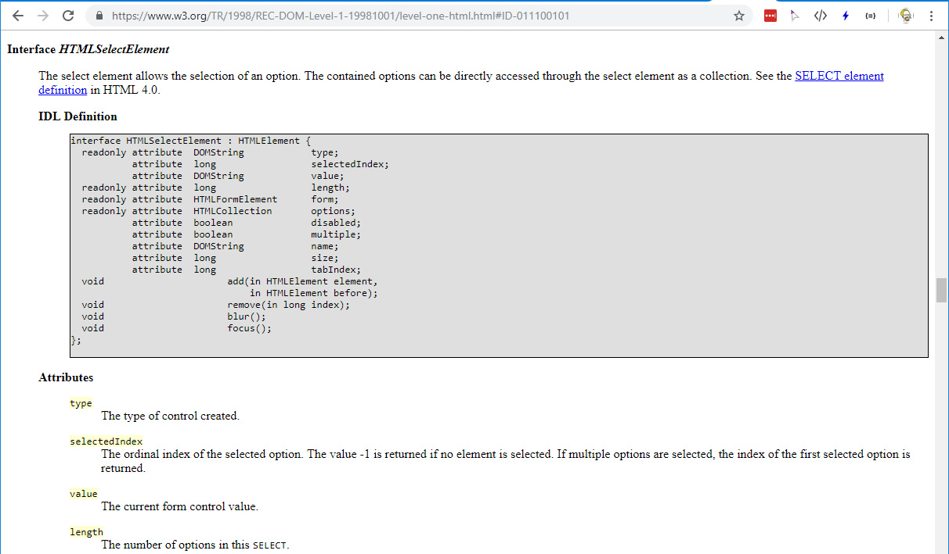
Notes:
And unsurprisingly,
the focus subsystem hasn't
changed significantly
since then.
And that's fine.
It's a 20 year old API
and it does its job.
Until it doesnt.

Slide 38
DUM DUM DUM
The Plot Thickens!

Slide 39
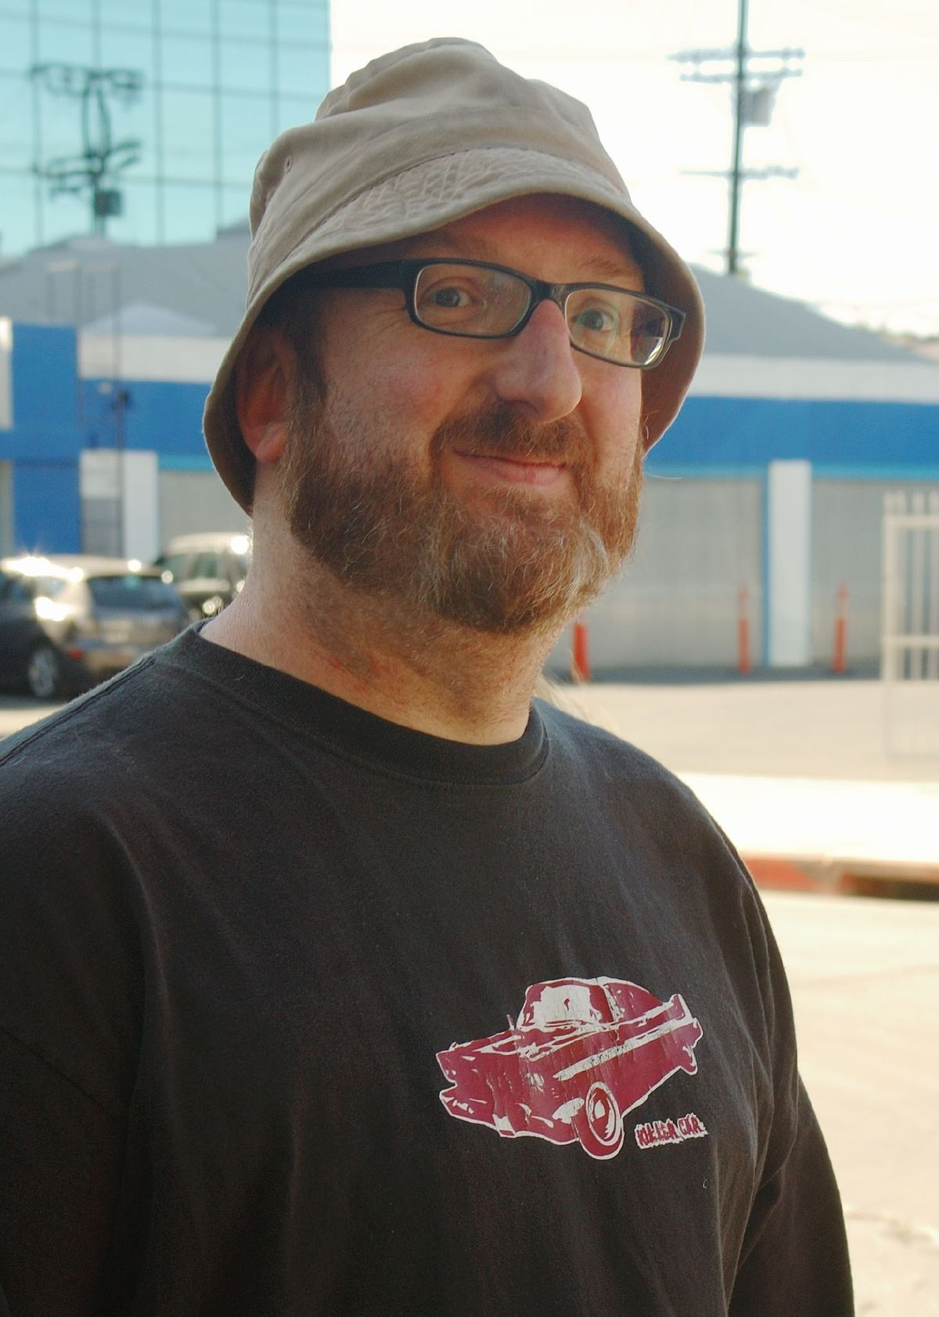
Not really Glen…
But pretend it is and he's as dashing as
international
heart-throb
Brian Posehn…
Notes:
Say you are
an incredibly dashing
web developer
named glen.

Slide 40
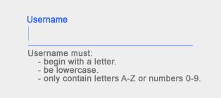
Notes:
And you need to write a web component
that wraps a single field
for entering a username.

Slide 41

Notes:
And your customer comes to you
and says that the focus
when you press ENTER
should automatically advance
to the next field.
This is a pretty common request
for customers to make.
So our code might look like this:

Slide 42
import {ZephComponents,html,onEventAt} from "ZephJS";
ZephComponents.define("my-user-field",()=>{
html(`
<div class="wrapper">
<input class="field" type="text"></input>
</div>
`);
onEventAt("input","keyup",(element,content,event)=>{
if (event.keyCode===13) {
???????????????
}
});
});
Notes:
A note here...
I'm using ZephJS to define
the web component.

Slide 43

zephjs.com
Notes:
ZephJS is a
tiny and powerful way
to write web components
super easily.
I find it simplifies
all my web component work greatly.
You can check it out at
zephjs.com
Anyway
back to our story.

Slide 44
zephjs.com
Notes:
We have a customer
that wants a web component
for entering a username
they can re-use
AND it must advance the focus
when ENTER is pressed.
Here's our code again

Slide 45
import {ZephComponents,html,onEventAt} from "ZephJS";
ZephComponents.define("my-user-field",()=>{
html(`
<div class="wrapper">
<input class="field" type="text"></input>
</div>
`);
onEventAt("input","keyup",(element,content,event)=>{
if (event.keyCode===13) {
???????????????
}
});
});
Notes:
I'll walk through this
very quickly.

Slide 46
import {ZephComponents,html,onEventAt} from "ZephJS";
ZephComponents.define("my-user-field",()=>{
html(`
<div class="wrapper">
<input class="field" type="text"></input>
</div>
`);
onEventAt("input","keyup",(element,content,event)=>{
if (event.keyCode===13) {
???????????????
}
});
});
Notes:
To begin
we import what we need
from ZephJS.
In this case
we need the ZephComponents object
and the html() and onEventAt()
definition methods.

Slide 47
import {ZephComponents,html,onEventAt} from "ZephJS";
ZephComponents.define("my-user-field",()=>{
html(`
<div class="wrapper">
<input class="field" type="text"></input>
</div>
`);
onEventAt("input","keyup",(element,content,event)=>{
if (event.keyCode===13) {
???????????????
}
});
});
Notes:
Then,
Using the ZephComponents.define() function,
we define our "my-user-field" component.
To define a component,
we give it a name,
"my-user-field"
and a method
that contains all of our
component definitions.
This component
has two definition methods…

Slide 48
import {ZephComponents,html,onEventAt} from "ZephJS";
ZephComponents.define("my-user-field",()=>{
html(`
<div class="wrapper">
<input class="field" type="text"></input>
</div>
`);
onEventAt("input","keyup",(element,content,event)=>{
if (event.keyCode===13) {
???????????????
}
});
});
Notes:
First,
we define the HTML content
of our Web Component
using ZephJS's
html() definition method
and giving it the html content.

Slide 49
import {ZephComponents,html,onEventAt} from "ZephJS";
ZephComponents.define("my-user-field",()=>{
html(`
<div class="wrapper">
<input class="field" type="text"></input>
</div>
`);
onEventAt("input","keyup",(element,content,event)=>{
if (event.keyCode===13) {
???????????????
}
});
});
Notes:
Second,
We tell ZephJS
how we want to handle
the KEYUP event
on the INPUT element
within our HTML content.

Slide 50
import {ZephComponents,html,onEventAt} from "ZephJS";
ZephComponents.define("my-user-field",()=>{
html(`
<div class="wrapper">
<input class="field" type="text"></input>
</div>
`);
onEventAt("input","keyup",(element,content,event)=>{
if (event.keyCode===13) {
???????????????
}
});
});
Notes:
That's it.
That's our
admittedly simple
web component definition
for our username field.
Once defined
anytime the <my-user-field> element
is used within the html document
this code will be used.
Now, most of you will notice
this line right here.

Slide 51
import {ZephComponents,html,onEventAt} from "ZephJS";
ZephComponents.define("my-user-field",()=>{
html(`
<div class="wrapper">
<input class="field" type="text"></input>
</div>
`);
onEventAt("input","keyup",(element,content,event)=>{
if (event.keyCode===13) {
???????????????
}
});
});
Notes:
This is where we want
to put the code
to change the focus
when the ENTER key is pressed.
But there's a problem here.
See,
A Web Component
is intentionally designed
to be re-used repeatedly.

Slide 52
import {ZephComponents,html,onEventAt} from "ZephJS";
ZephComponents.define("my-user-field",()=>{
html(`
<div class="wrapper">
<input class="field" type="text"></input>
</div>
`);
onEventAt("input","keyup",(element,content,event)=>{
if (event.keyCode===13) {
???????????????
}
});
});
Notes:
So how does our code
know where to advance
our focus to?
If you recall earlier,
we have a method called
element.focus()

Slide 53
Properties
document.activeElement
Methods
element.focus()
element.blur()
Events
focus
blur
focusin
focusout
Notes:
That is used to set the focus
to some element.
But in order to set the focus
we have to KNOW the element
we want to set it to.
A Web Component is built
to actively NOT KNOW.

Slide 54
import {ZephComponents,html,onEventAt} from "ZephJS";
ZephComponents.define("my-user-field",()=>{
html(`
<div class="wrapper">
<input class="field" type="text"></input>
</div>
`);
onEventAt("input","keyup",(element,content,event)=>{
if (event.keyCode===13) {
???????????????
}
});
});
Notes:
Our web component is
completely encapsulated
and knows nothing about
what exists outside of it.
Using the current focus subsystem
We have no easy way
to just tell the focus
to advance to the next place.
This is the first problem
I want to call your attention to
with the current focus subsystem.
No programmatic way to move the focus.

Slide 55
import {ZephComponents,html,onEventAt} from "ZephJS";
ZephComponents.define("my-user-field",()=>{
html(`
<div class="wrapper">
<input class="field" type="text"></input>
</div>
`);
onEventAt("input","keyup",(element,content,event)=>{
if (event.keyCode===13) {
???????????????
}
});
});
Notes:
Now,
Some of you are
probably thinking
just walk the tree
starting at the current element
and locate the next element
which can receive focus
and advance to that.

Slide 56
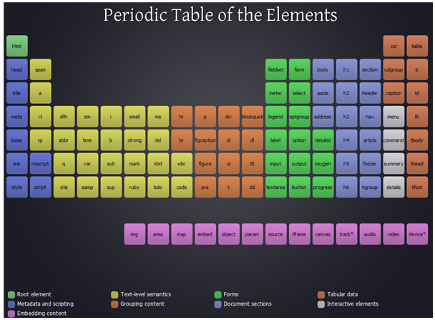
Notes:
But this brings the second problem
with our current focus subsystem…
What makes an element
able to receive focus?
What indicates something is focusable?
And there are some
easy answers here…
If the element is an INPUT tag

Slide 57
Notes:
or SELECT tag

Slide 58
Notes:
or Link

Slide 59
Notes:
or BUTTON tag

Slide 60
Notes:
or TEXTAREA tag

Slide 61
Notes:
or CONTENT EDITABLE

Slide 62
Notes:
<PAUSE>
EXCEPT

Slide 63
EXCEPT!
Notes:
If it is DISABLED

Slide 64
?
Notes:
or TABINDEX is equal to
negative one
or it is HIDDEN
or within a
disabled FIELDSET
or FORM
or otherwise not VISIBLE
or not INERT
or…
etc etc etc

Slide 65
?
Notes:
See, determining what is Focusable
is really hard.
and even more problematic
is that it is
incredibly inconsistent
across different browsers.
Someone even made
a fancy chart

Slide 66
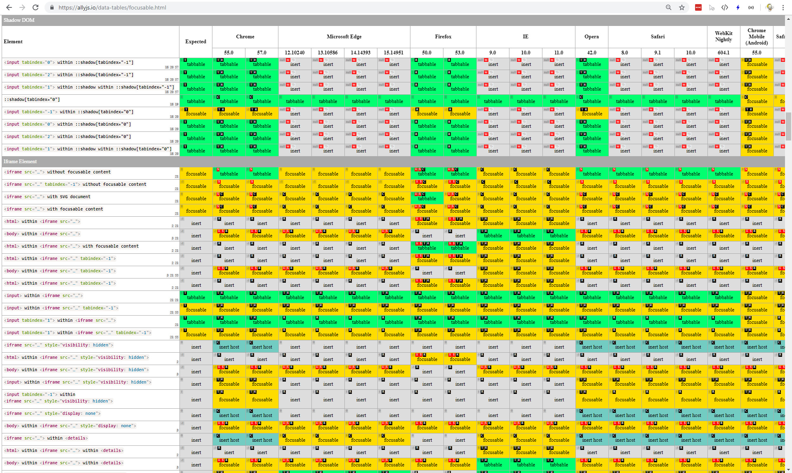
Notes:
which I tried to shrink down
and get onto one slide
but there are just
too many edge cases.
Of course,
we can always go to the Spec
and that should be
super easy to understand.

Slide 67
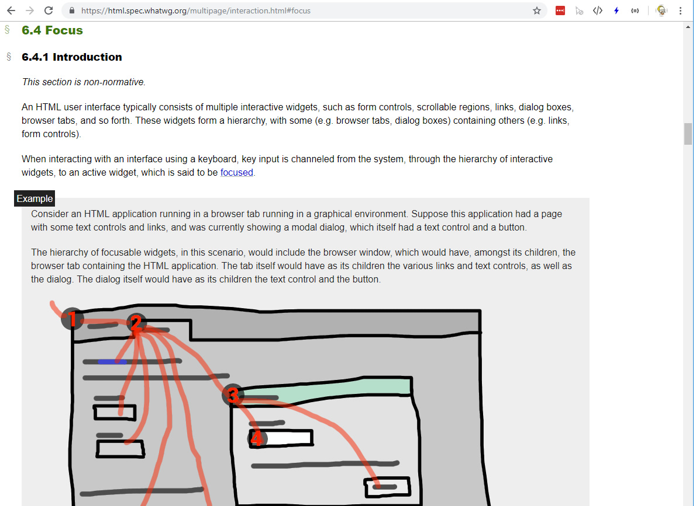
Notes:
Section 6.4 of the HTML Specification
details the focus subsystem.
Here's what it says about what is focusable

Slide 68
Elements that have their tabindex focus flag set, that are not actually disabled, that are not expressly inert, and that are either being rendered or being used as relevant canvas fallback content.
Notes:
Elements that have
their tabindex focus flag set,
that are not actually disabled,
that are not expressly inert,
and that are either being rendered
or being used as relevant canvas fallback content.

Slide 69
Elements that have their tabindex focus flag set, that are not actually disabled, that are not expressly inert, and that are either being rendered or being used as relevant canvas fallback content.
The shapes of area elements in an image map associated with an img element that is being rendered and is not expressly inert.
Notes:
The shapes of area elements
in an image map
associated with an img element
that is being rendered
and is not expressly inert.

Slide 70
Elements that have their tabindex focus flag set, that are not actually disabled, that are not expressly inert, and that are either being rendered or being used as relevant canvas fallback content.
The shapes of area elements in an image map associated with an img element that is being rendered and is not expressly inert.
The user-agent provided subwidgets of elements that are being rendered and are not actually disabled or expressly inert
Notes:
The user-agent
provided subwidgets
of elements
that are being rendered
and are not actually disabled
or expressly inert

Slide 71
Elements that have their tabindex focus flag set, that are not actually disabled, that are not expressly inert, and that are either being rendered or being used as relevant canvas fallback content.
The shapes of area elements in an image map associated with an img element that is being rendered and is not expressly inert.
The user-agent provided subwidgets of elements that are being rendered and are not actually disabled or expressly inert
The scrollable regions of elements that are being rendered and are not expressly inert.
Notes:
The scrollable regions
of elements
that are being rendered
and are not expressly inert.

Slide 72
Elements that have their tabindex focus flag set, that are not actually disabled, that are not expressly inert, and that are either being rendered or being used as relevant canvas fallback content.
The shapes of area elements in an image map associated with an img element that is being rendered and is not expressly inert.
The user-agent provided subwidgets of elements that are being rendered and are not actually disabled or expressly inert
The scrollable regions of elements that are being rendered and are not expressly inert.
The viewport of a Document that is in a browsing context and is not inert.
Notes:
The viewport
of a Document
that is in a browsing context
and is not inert.

Slide 73
Elements that have their tabindex focus flag set, that are not actually disabled, that are not expressly inert, and that are either being rendered or being used as relevant canvas fallback content.
The shapes of area elements in an image map associated with an img element that is being rendered and is not expressly inert.
The user-agent provided subwidgets of elements that are being rendered and are not actually disabled or expressly inert
The scrollable regions of elements that are being rendered and are not expressly inert.
The viewport of a Document that is in a browsing context and is not inert.
Any other element or part of an element, especially to aid with accessibility or to better match platform conventions.
Notes:
Any other element
or part of an element,
especially to aid with accessibility
or to better match platform conventions.

Slide 74
Elements that have their tabindex focus flag set, that are not actually disabled, that are not expressly inert, and that are either being rendered or being used as relevant canvas fallback content.
The shapes of area elements in an image map associated with an img element that is being rendered and is not expressly inert.
The user-agent provided subwidgets of elements that are being rendered and are not actually disabled or expressly inert
The scrollable regions of elements that are being rendered and are not expressly inert.
The viewport of a Document that is in a browsing context and is not inert.
Any other element or part of an element, especially to aid with accessibility or to better match platform conventions.
Notes:
And I dont know about you
but I find this complicated
and confusing
as hell.
and honestly,
I really dont want to write
a method that tries
to figure this out
becuase,
lets face it,
I am almost certainly
going to get it wrong.
<pause>

Slide 75
Notes:
So we essentially have two problems

Slide 76
1
No way to automatically advance (or reverse) focus
Notes:
we have no easy way
to advance the focus
automatically.
(Or decrement the focus automatically)

Slide 77
1
No way to automatically advance (or reverse) focus
2
No way to determine
what is focusable
Notes:
and we have no easy way
to determine what can receive focus,
what is focusable,
if we wanted to walk the tree.

Slide 78
1
No way to automatically advance (or reverse) focus
2
No way to determine
what is focusable
Notes:
And the annoying thing about
these two problems
is that internally
in the browsers,
both these problems
are already solved.

Slide 79
1
No way to automatically advance (or reverse) focus
2
No way to determine
what is focusable
Notes:
The browsers,
internally,
have a means to determine
if an element is focusable
and they have a means
to advance the focus to
the next focusable element.
<quick pause>

Slide 80
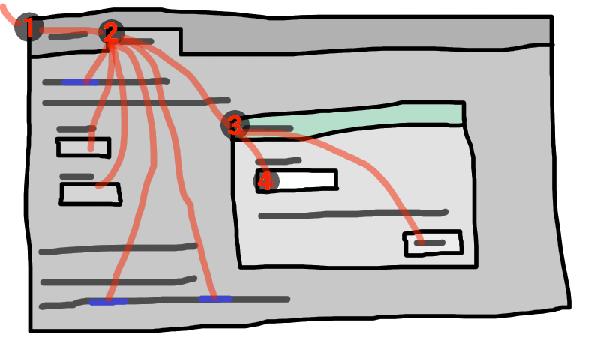
Notes:
The focus subsystem today,
is mostly a passive thing.
we can read it,
we can tell where the focus is
and when it changes,
and we can direct it
if we know exactly
where to direct it.
And this is okay...
but ITS NOT ENOUGH.

Slide 81
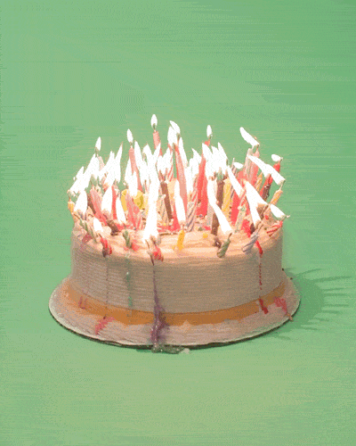
Notes:
It's a twenty year old API
and it is really
starting to show its age.
it could do more
it could be easier
it could be more powerful.
And all of That
begins
with exposing
three simple functions...

Slide 82
.isFocusable(e)
Notes:
First,
expose the method
to determine if something
can receive the focus.
I call this, isFocusable(e)

Slide 83
.isFocusable(e)
.forward()
.backward()
Notes:
Second and Third,
expose the methods
to move the focus
forward or backward
regardless of where
the focus currently is.
I call these
forward() and backward().

Slide 84
.isFocusable(e)
.forward()
.backward()
Notes:
And consider
what other focus things
could we expose
or add
to make focus better?

Slide 85
.isFocusable(e)
.forward()
.backward()
.trap()
Notes:
What about a function
to trap (aka limit)
focus to a particular container?
meaning focus would cycle
within the focusable elements
in that container,
but never out of it
until told otherwise.

Slide 86
.isFocusable(e)
.forward()
.backward()
.trap()
.order()
Notes:
What about a programmatic way
to order the focusable
elements and enforce
that order.
Sure we have tabindex
to do that
but wouldn't a function
that takes an array of the elements
and does the ordering for us
be really helpful?

Slide 87
.isFocusable(e)
.forward()
.backward()
.trap()
.order()
Notes:
And there are other
things that could really make
focus more understandable.
Lots more.

Slide 88
.isFocusable(e)
.forward()
.backward()
.trap()
.order()
.previousActiveElement
.history
Notes:
a previousActiveElement property
or history array
of what was previously focused
could be nice.

Slide 89
.isFocusable(e)
.forward()
.backward()
.trap()
.order()
.previousActiveElement
.history
.autofocus(e)
Notes:
A programmatic way
to set an element
as the first element
to get the focus
once the page is loaded
might be nice.

Slide 90
.isFocusable(e)
.forward()
.backward()
.trap()
.order()
.previousActiveElement
.history
.autofocus(e)
???
Notes:
And probably other things
We haven't even considered.
<pause>

Slide 91
.isFocusable(e)
.forward()
.backward()
.trap()
.order()
.previousActiveElement
.history
.autofocus(e)
???
Notes:
So naturally,
when you have all these
great ideas to add to browsers
we write a new library
and publish it
to the INTERNET
and everyone
will instantly use it
and throw flowers at your feet
and shower you with praise.

Slide 92
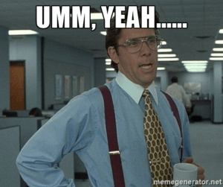
Notes:
I set out to do that
about six months ago.
I started with a library
called "Tabbable"
written by David Clark.

Slide 93
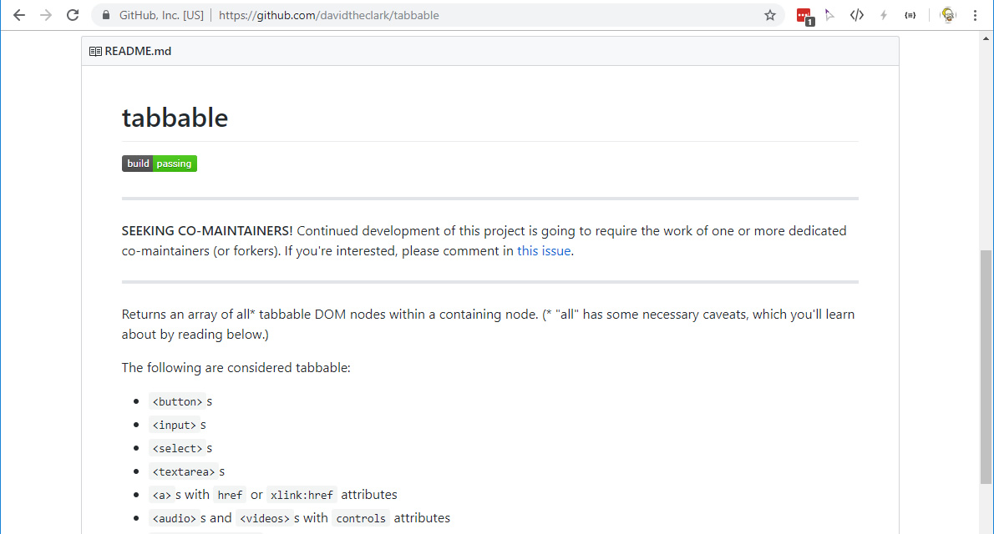
Notes:
Tabbable will return an array
of all descendant nodes
for a given node
which meet Tabbables internal definition
of what is a focusable element.
I didnt want to try
and write my own
isFocusable() method,
So naturally,
I "stole" the one from Tabbable.
From there I added a global object
to window
called focusManager

Slide 94
window.focusManager
Notes:
for housing
my new focus functions.
And about this time
I started thinking

Slide 95
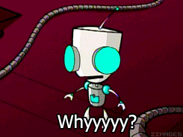
Notes:
why am *I* writing a library?
why doesn't the browser
just have these functions natively.
And if not,
is this something I could get changed?
surely, this something
everyone would want!
<pause>

Slide 96
Notes:
So let me tell you
how you go about changing
the HTML Specification.
First, as most of you may be aware
there are two separate
governing bodies
maintaining the HTML standard
at the same time.
The W3C

Slide 97

Notes:
And the WHATWG

Slide 98
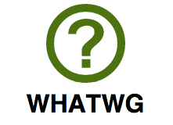
Notes:
And until about three months ago
they worked independently
of one another

Slide 99
Notes:
but tacitly acknowledging
one another.
However,
In May of 2019
both the W3C and WHATWG
signed an agreement
to work together

Slide 100
Notes:
with the HTML Specification
work being done
entirely in the WHATWG.
This is great news for everyone.
we finally have a single body
overseeing the HTML standard.
<quick pause>
Now,
let us say that you are
an incredibly dashing,

Slide 101
Still not Glen…
But let's pretend
Glen is this cool
and popular…
Notes:
but not super popular,
web developer
and you want to propose some changes
to the HTML specification.
How do you do that?
Well,
six months ago,
you would probably google
something like

Slide 102
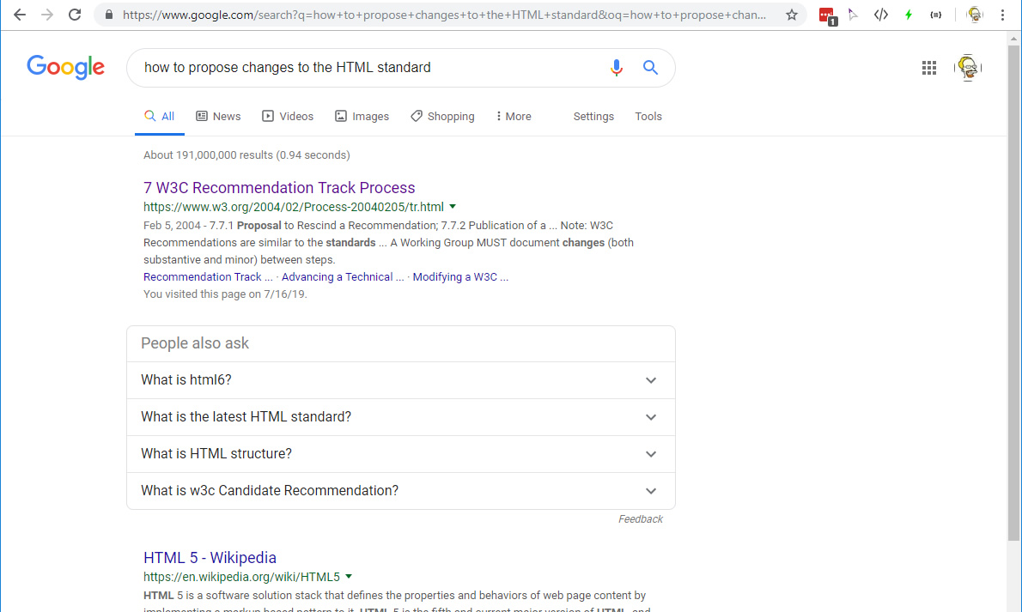
Notes:
"how to propose changes to the HTML standard"
And the first hit you get might be to
the W3C Process Document.
Which you would read
for a few minutes
<slowly>
and slowly

Slide 103

Notes:
feel the sanity
draining from you
as if cthulhu
himself
was sitting next to you
eating pie
and waiting for you to
wither away.
But if you were persistent
you might eventually find
something called the

Slide 104

Web Platform
Incubator
Community
Group
Notes:
Web Platform Incubator Community Group
or WICG
which was formed in 2015
to allow people
like you and I
to make proposals.
Wooohooo! Jackpot!
So you write up your idea
and submit it to the WICG
discourse group for discussion…

Slide 105
Web Platform
Incubator
Community
Group
Notes:
And then you wait
And like three people
read it
and one person comments on it,
and there's a tiny bit of discussion
but nothing else happens
for months.
And you begin to realize
that the either
the WICG Process
really doesn't work
or

Slide 106

Notes:
that perhaps your idea
is really garbage
and that you
are really garbage.
Thus begins
the spiral of

Slide 107
INTERNET
Self
Doubt
Notes:
INTERNET
SELF
DOUBT
Fortunately,
as the doubt was
just getting going
the aforementioned agreement
between the W3C and WHATWG
comes down

Slide 108
Notes:
and you realize
you need to get your proposal
in front of WHATWG eyeballs,
Not the WICG eyeballs,
and honestly,
more eyeballs everywhere.
So you open a ticket

Slide 109
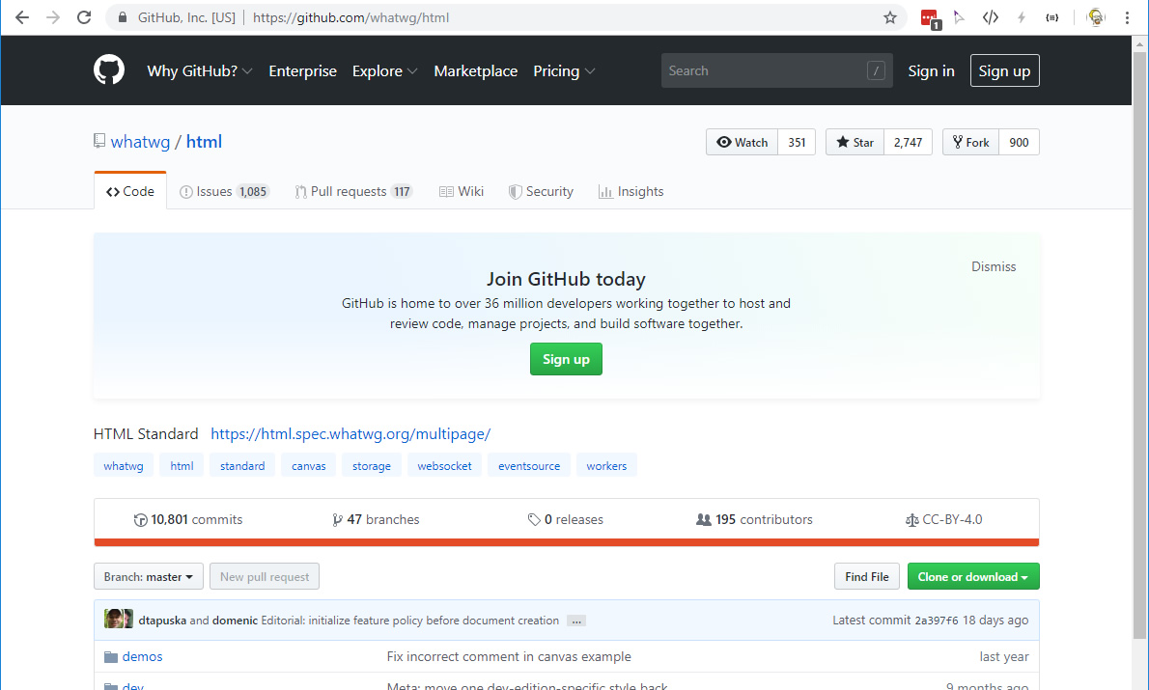
Notes:
on the WHATWG github.
and you write some articles
and post to reddit,

Slide 110





Notes:
hacker news,
and newsletters,
twitter,
etc.
And this being the internet
you get almost no feedback
except for people pooping

Slide 111
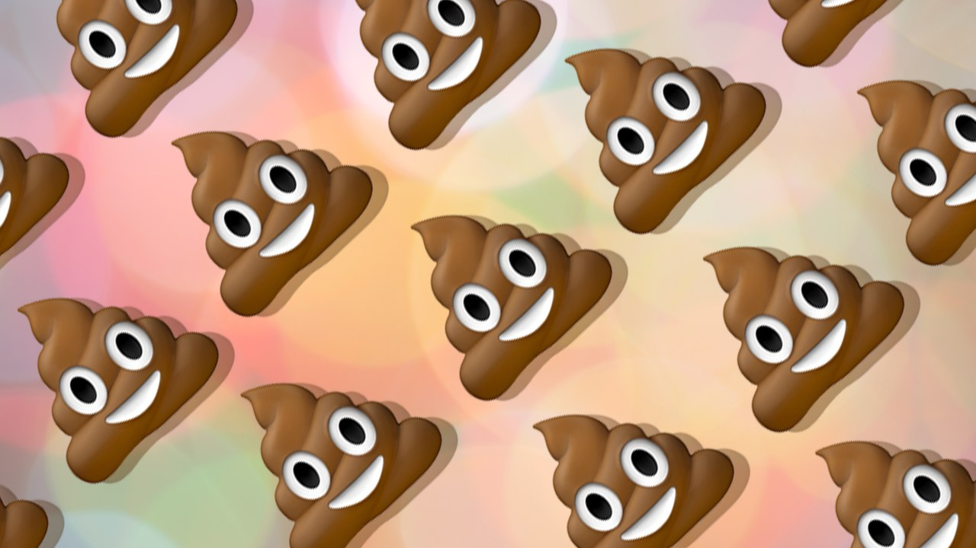
Notes:
on your idea
because it has no value
to them personally
so it must not have value
to anyone else.
and again you doubt yourself
and again you doubt your idea
and you wonder what to do next.
And then you have a greatest inspiration
you ever had...

Slide 112


Slide 115







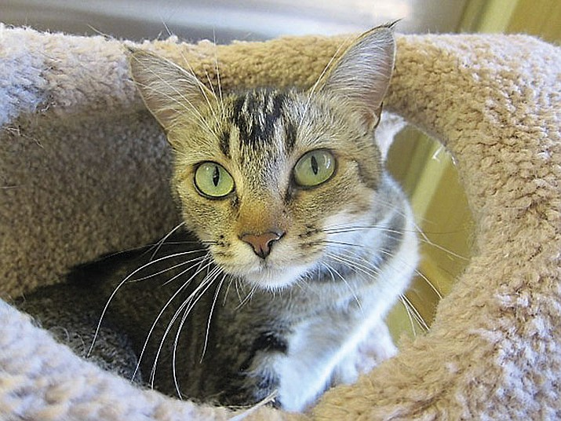


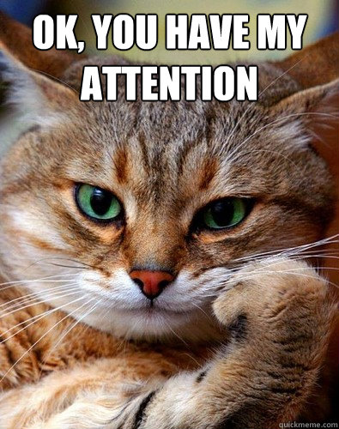





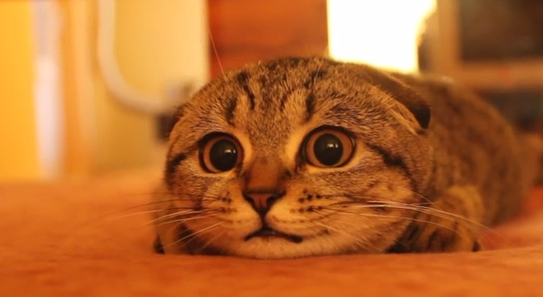






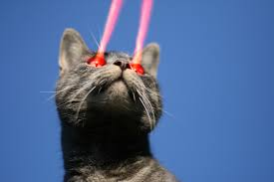













Slide 116

Notes:
And I’m not…
No, wait, that is me.
Long story.
Anyways,

Slide 117
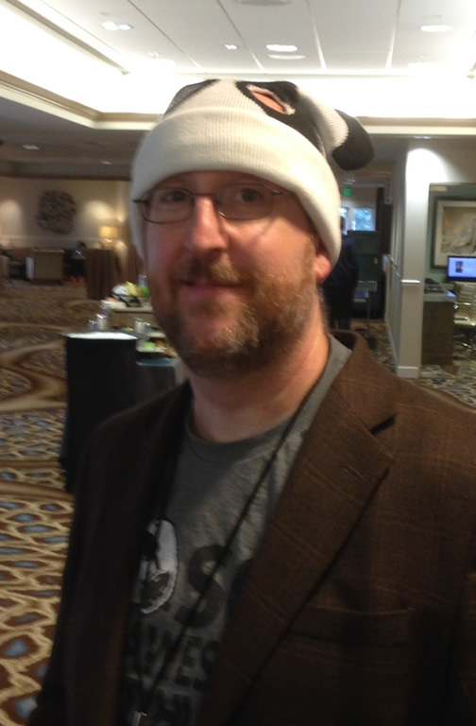
Glen R. Goodwin
@areinet
arei.net
github.com/arei
Notes:
Here I am.
You might know me from here at CharmCityJS
Or NodeSchool
Or from around the community.
But if you don’t…
these are my places…
<pause>
and I work for this company

Slide 118

Notes:
The Awesome Engineering Company.
Which makes libraries and enterprise applications
In nodejs for handling massive scale.
I'll hit you with a sales pitch in a few minutes.
But for now I'm here to talk to you about

